Slide 1
SIPOC
Production Inputs and Outputs

Slide 2
Objective
Enables efficient operations
Reduces waste such as:
To avoid delays in production process
Eliminate backlog in MO processing
To ensure all raw materials/components are added to an assembly BOM/version changed(avoid omissions)

Slide 3
SIPOC
Supplier | Inputs | Process | Outputs | Customer
Production Engineering | KP,STS & SDS BOM & WI | Production Eng | Complete BOM | Production
Supply chain | Goods inspection | Incoming QC | QC records | Stores
QA team | Raw materials QC status | Inventory receipt | GRN | Stores
Stores | MO | Sub assembly | Quality sub assemblies | Final Assembly/Maintenance
 |  | Final Assembly
Requirements:
Updated BOM (Fabrication tracker & Odoo) beforehand
KPRs for new items for hardware upgrades just in time after design approvals
Updated WIs

Slide 4
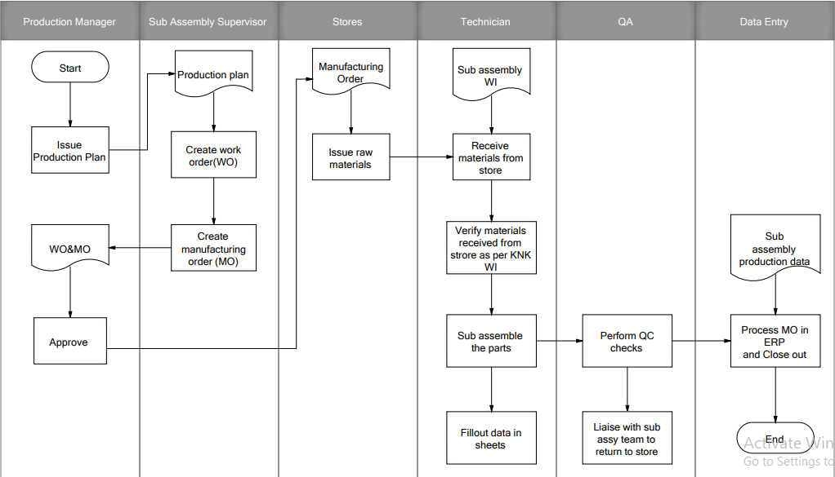
Sub Assembly Process Flow

Slide 5

Thank you.

